Slide 1
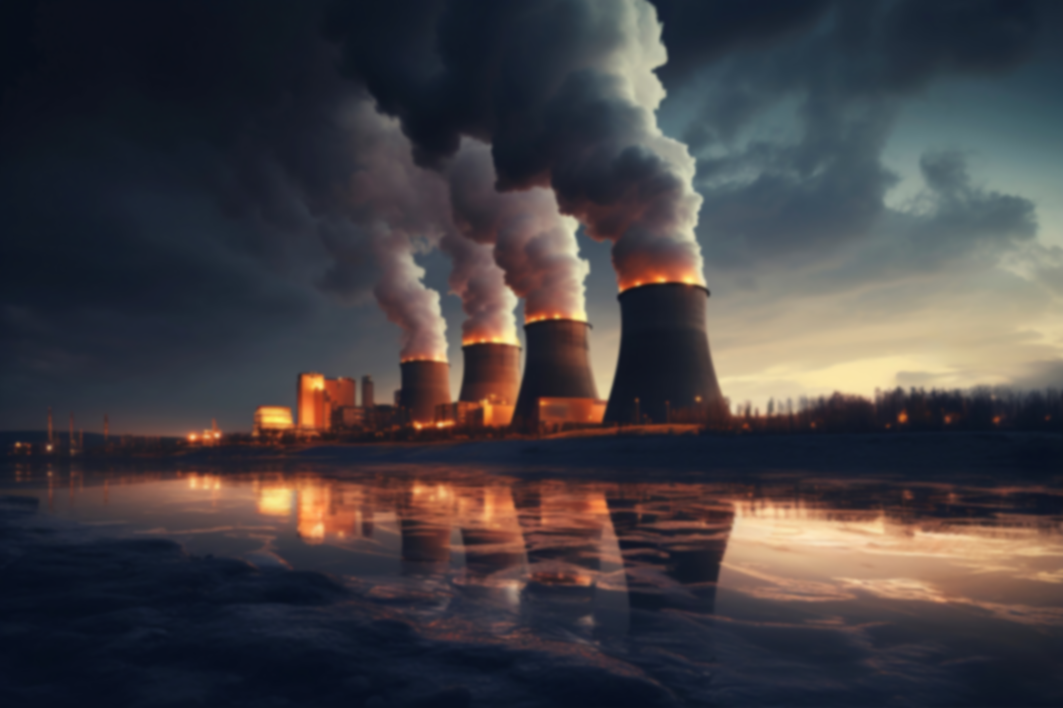

Engineering Ethics
CHERNOBYL
DISASTER
Group - 1

Slide 2
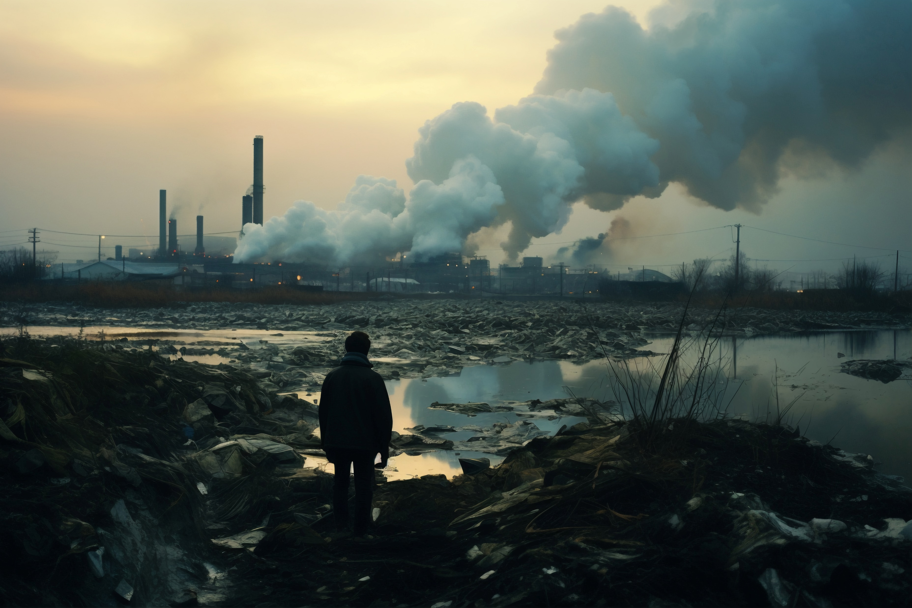

Engineering Ethics
CHERNOBYL
DISASTER
Group - 1

Slide 3
Table of contents
Introduction
01
02
Code of Ethics
Ethical Dilemma
03
Resolution of Dilemma
04
Conclusion
05
Group - 1
Engineering Ethics

Slide 4
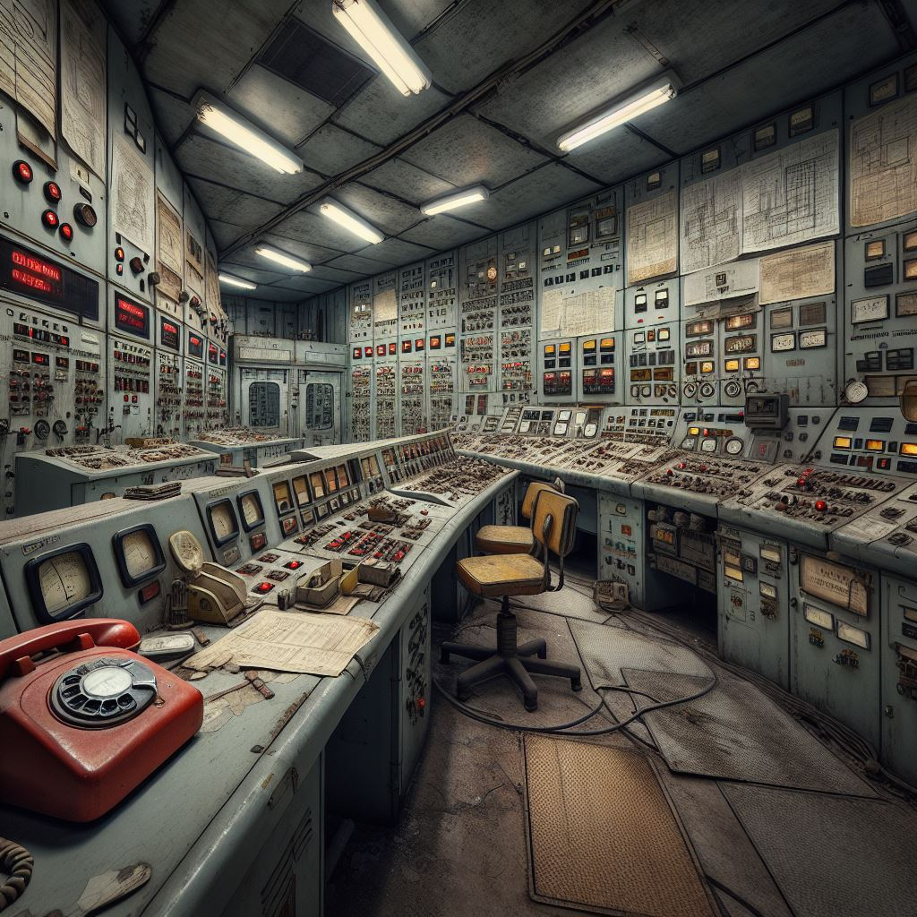
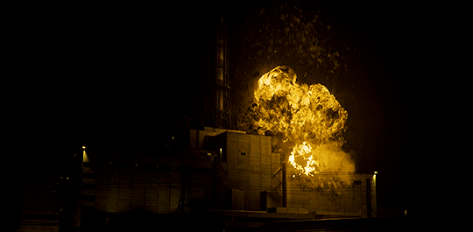
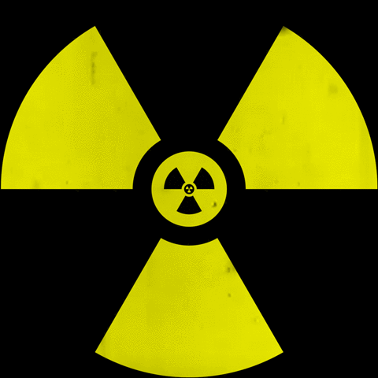
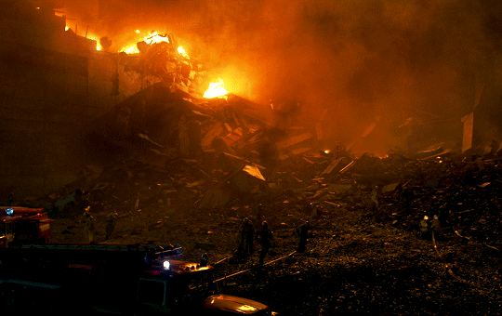
APRIL 25, 1986
PRIPYAT, NORTHEN UKRAIN
REACTOR 4 EXPLOSTION

Slide 5


TIMELINE
1:23 AM
SAFETY TEST
1:30 AM
POWER LEVEL DROP
1:40 AM
AZ-5
1:42 AM
EXPLOSION

Slide 6


Code of Ethics
02
What are Ethical Codes?
Guidelines for responsible engineering practices
Promote safety, integrity, and accountability
Why Are They Important?
Ensure public trust
Guide decision-making
Protect stakeholders
Group - 1
Engineering Ethics

Slide 7




02
Public Safety
in Engineering
Chosen Code
Engineers shall hold paramount the safety, health, and welfare of the public
Why It Matters?
Builds public trust
Prevents harm and risks
Group - 1
Engineering Ethics

Slide 8
Public Safety
in Engineering
02
Application
Safe infrastructure
Medical devices
Environmental protection
Real-World Scenarios
Bridge and building safety
Clean energy projects
Reliable medical technologies
Group - 1
Engineering Ethics

Slide 9

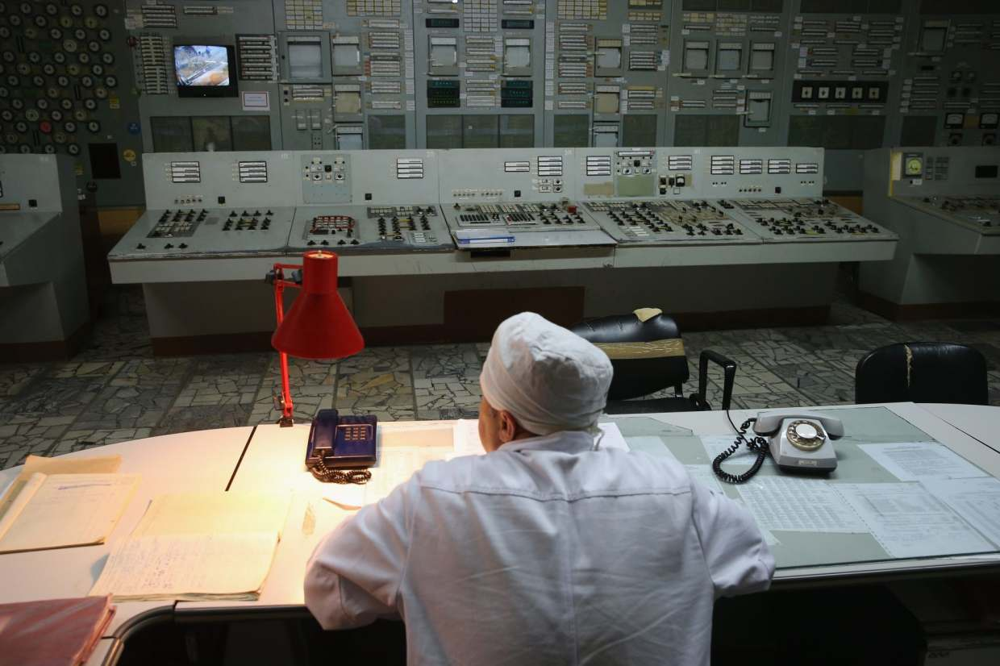
Ethical Code in Context
02
Violation of Ethical Code
Ethics vs. Pressure
Ignored safety protocols
1.Should workers follow unsafe orders or refuse and face punishment?
2. Should they stop the test due to inexperience or continue under pressure?
3. Should they delay the test for safety or proceed to meet expectations?
4. Should they speak out despite threats or stay silent to protect themselves?
Reactor design flaws
Poor operator training
Lack of communication
Neglected public safety
Group - 1
Engineering Ethics

Slide 10

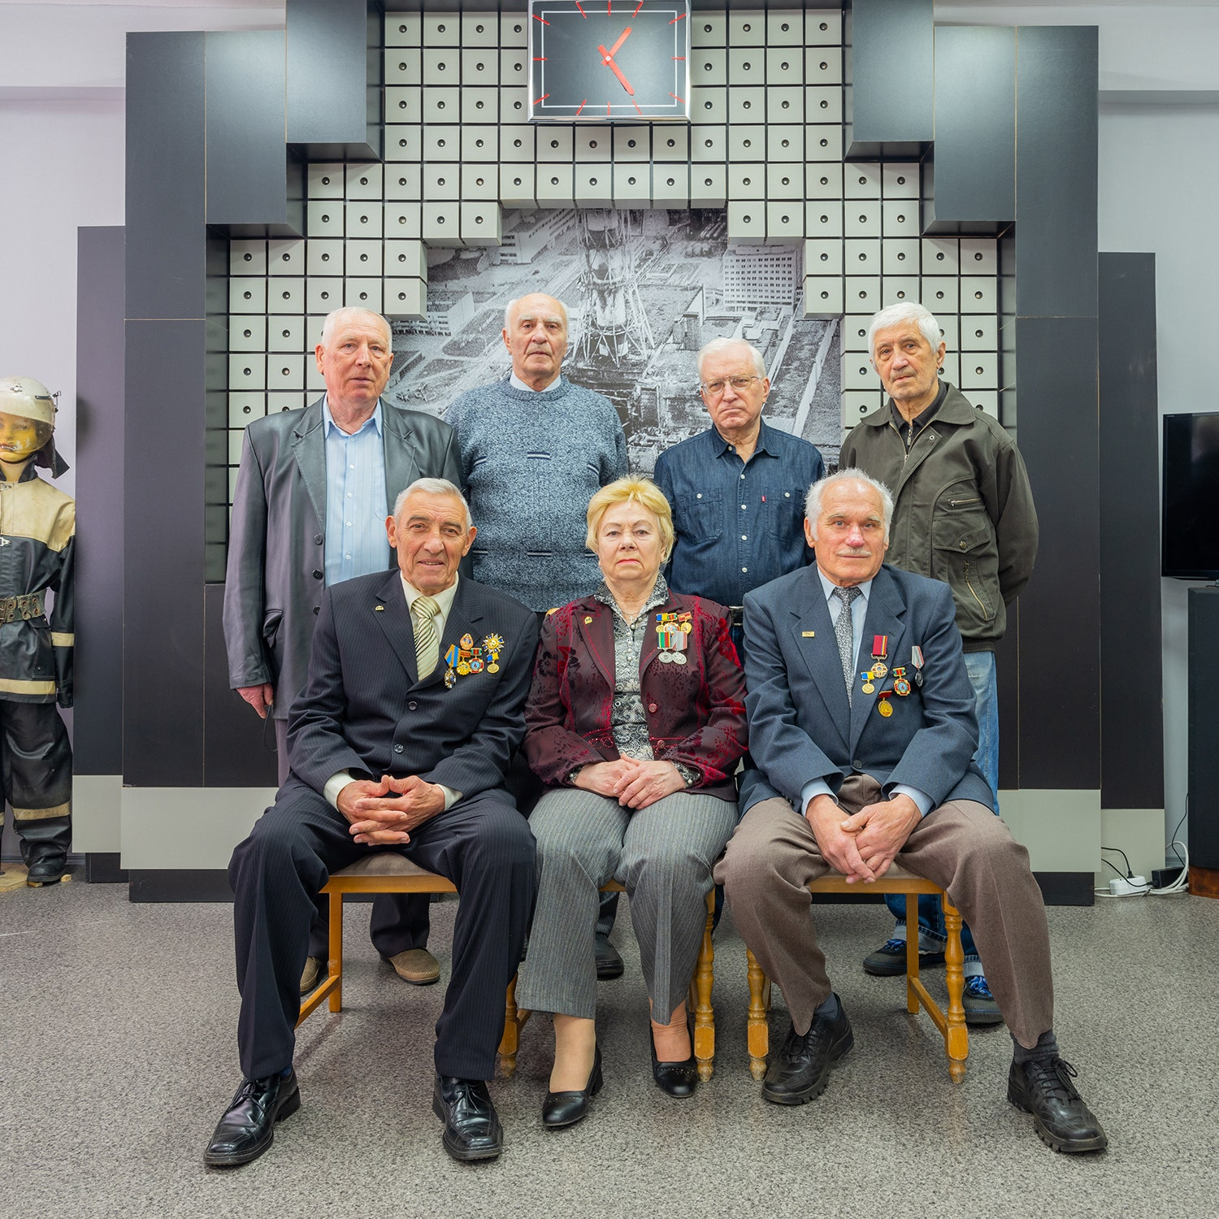
Ethical Dilemma
Safety vs. Expectations
Ethics vs. Pressure
1.Should workers follow unsafe orders or refuse and face punishment?
2. Should they stop the test due to inexperience or continue under pressure?
3. Should they delay the test for safety or proceed to meet expectations?
4. Should they speak out despite threats or stay silent to protect themselves?
5. Should they reveal the flaw to save lives or hide it to protect the government’s image?
6.Should they evacuate immediately and risk panic or delay to avoid attention?
7. Should they warn workers of the risks or hide the truth to ensure cleanup was done?

Slide 11
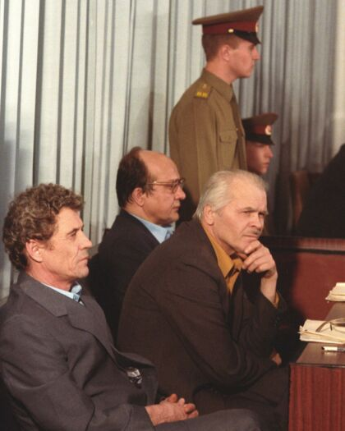
Ethical Dilemma…
Safety vs. Expectations
Responsibility vs. Self-preservation
5. Should they reveal the flaw to save lives or hide it to protect the government’s image?
6.Should they evacuate immediately and risk panic or delay to avoid attention?
7. Should they warn workers of the risks or hide the truth to ensure cleanup was done?
8. Should they take responsibility or find scapegoats to protect their image?
9. Should they risk their career to warn others or stay silent under pressure?

Slide 12
Ethical Dilemma…
.
2. Gather the Relevant Facts
Test conducted under unsafe conditions to improve reactor safety.
Safety systems disabled during the test.
Reactor’s low-power instability and design flaws were known but hidden.
Soviet bureaucracy discouraged transparency and oversight
Responsibility vs. Self-preservation
8. Should they take responsibility or find scapegoats to protect their image?
9. Should they risk their career to warn others or stay silent under pressure?
1. Identify the Ethical Issues
Deadlines prioritized over safety, disabling critical systems.
Operators lacked training to understand risks.
Management pressured unsafe testing.
Hidden design flaws left operators unprepared.
3. Evaluate the Options
Halt the Test
Proceed with Caution
•Proceed as Planned

Slide 13
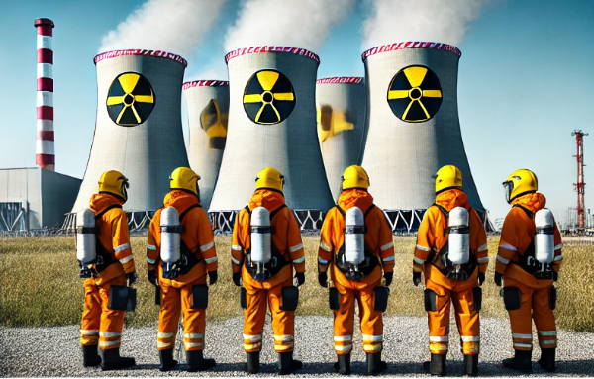
Resolutions of Dilemmas
.
1. Identify the Ethical Issues
Deadlines prioritized over safety, disabling critical systems.
Operators lacked training to understand risks.
Management pressured unsafe testing.
Hidden design flaws left operators unprepared.
2. Gather the Relevant Facts
Test conducted under unsafe conditions to improve reactor safety.
Safety systems disabled during the test.
Reactor’s low-power instability and design flaws were known but hidden.
Soviet bureaucracy discouraged transparency and oversight
3. Evaluate the Options
Halt the Test
Proceed with Caution
•Proceed as Planned

Slide 14
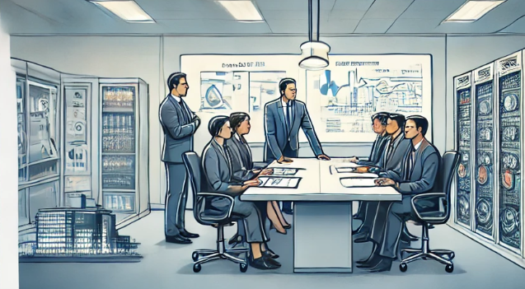

Resolutions of Dilemmas
.
4. Make a Decision and Justify
Safety-First Culture
Comprehensive Training and Education

Slide 15
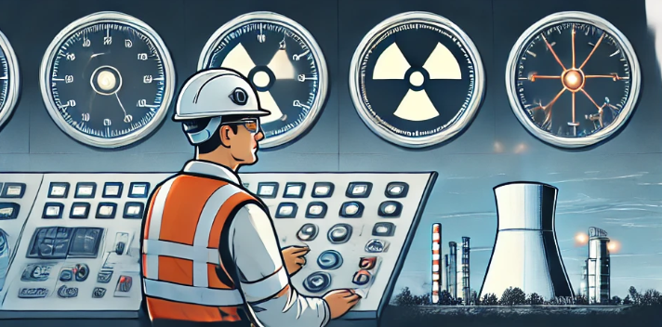
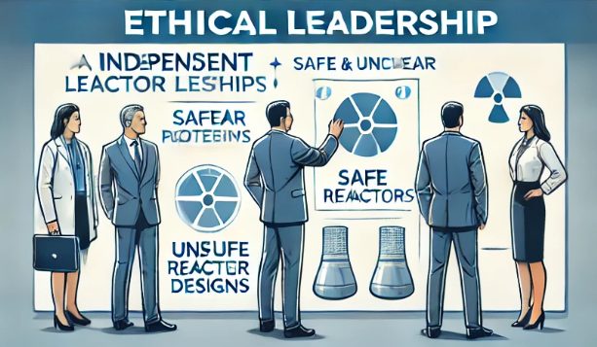
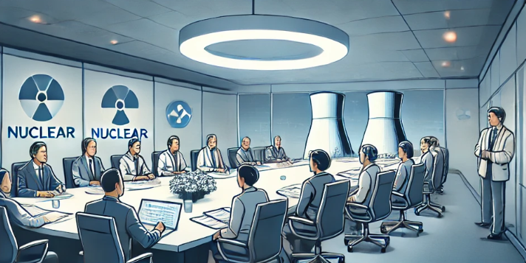
Resolutions of Dilemmas
Transparency in Design and Operation
Independent Oversight and Regulation
Group - 1
Engineering Ethics

Slide 16
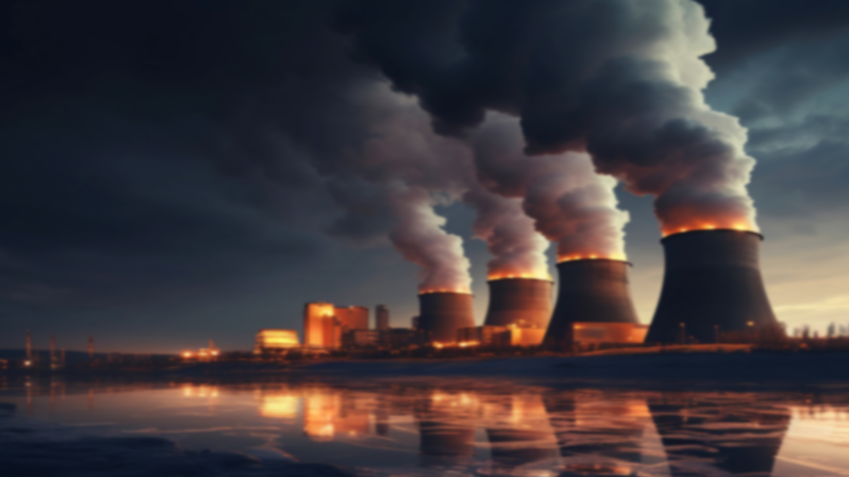
Resolutions of Dilemmas
Decision-Making Under Uncertainty
Ethical Leadership and Accountability
International Collaboration

Slide 17


Preventive Actions
Conclusion
01
Ensure proper training, adherence to safety protocols, and improved reactor design.
Group - 1
Engineering Ethics

Slide 18
Role of Engineering Ethics
02
Conclusion
Emphasize accountability, safety-first principles, and ethical decision-making.
Group - 1
Engineering Ethics

Slide 19
Relevance of Ethical Code
Conclusion
03
Highlights the need for safety, integrity, and professional responsibility.
Group - 1
Engineering Ethics

Slide 20




Accountability
04
Conclusion
Shared responsibility among engineers, management, and regulators.
Group - 1
Engineering Ethics

Slide 21
Any
Question?
Group - 1
Engineering Ethics

